Slide 1
Proposals for
Northwind

Slide 2
Problems to solve
Does discount affect the quantity of a product in an order?
Does discount affect quantity ordered in different regions?
1
3
2
Does discount amount affect the average revenue made per product?
4
Does the average amount spent per order change by region?

Slide 3
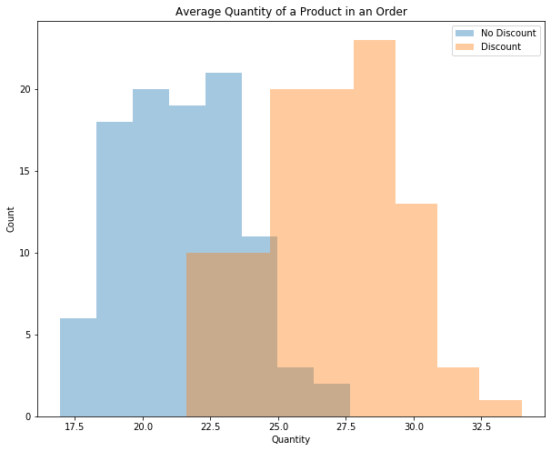
Does discount affect quantity ordered?
Discounted products are ordered in higher quantities than non discounted products
On average, discounted products sell 5 more units than non discounted products

Slide 4
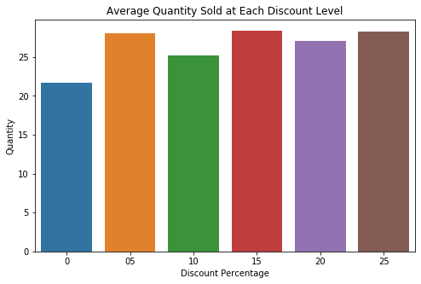
Does discount affect quantity ordered?
Average quantity ordered for non discounted products is 21
5%, 15%, and 25% average the highest quantity ordered at 28

Slide 5
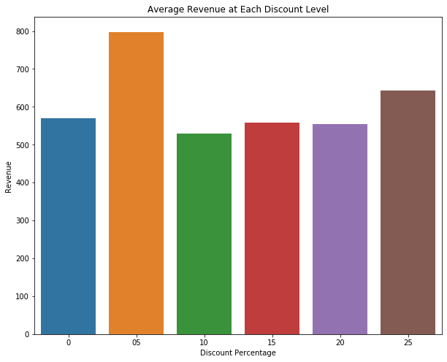
Does discount affect revenue?
Most discount levels do not affect average revenue when compared to no discount
A discount level of 5% averages $230 more dollars than no discount

Slide 6
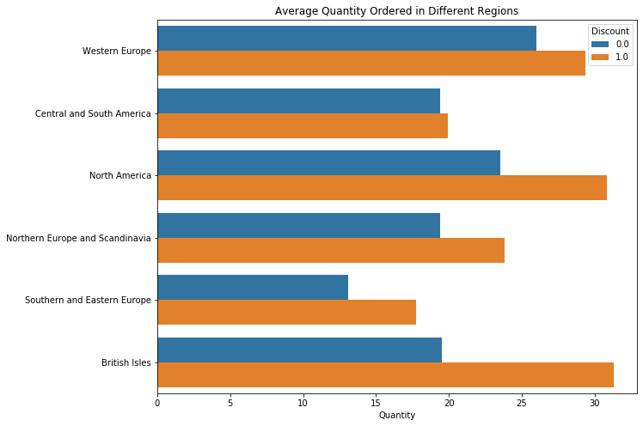
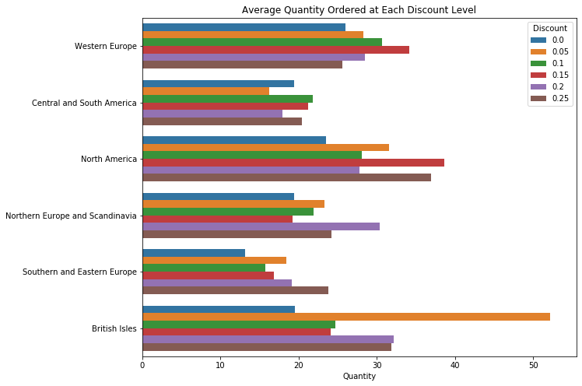
How Does Discount Affect Quantity in Different Regions

Slide 7
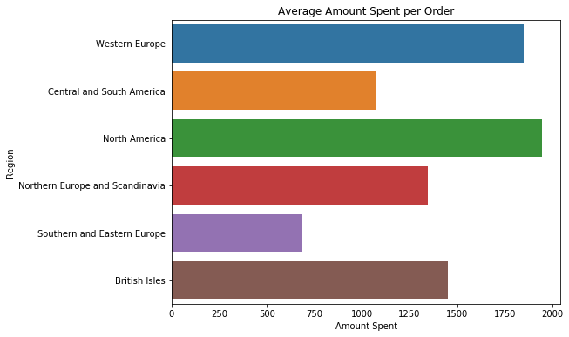
Does average amount spent differ by region?
Western Europe and North America average the largest orders
Central/South America and Southern/Eastern Europe spend much less per order than average

Slide 8
Things to Consider
Why is the average revenue from orders from Central and South America and Southern and Eastern Europe so much smaller than the other regions?
Price per product may differ between regions
More expensive products might be ordered more in other regions
Can you optimize discount levels for each region to maximize quantity ordered or revenue?

Slide 9
Thank you.

